Slide 1


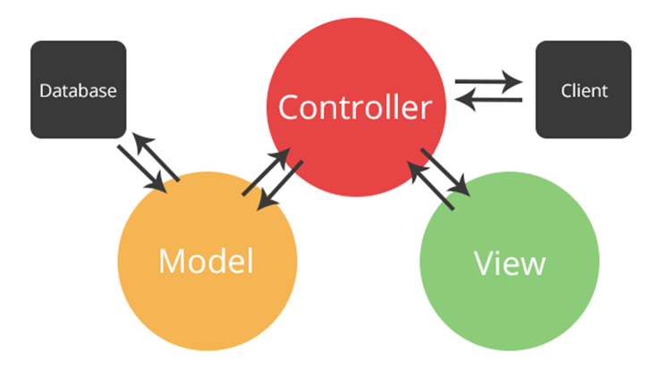

JavaScript: MVC and ExpressJS
MVC Architecture, ExpressJS Framework
Node.js, MVC in JavaScript, Handlebars
MVC
& ExpressJS
SoftUni Team
Technical Trainers
Software University
http://softuni.bg

Slide 2

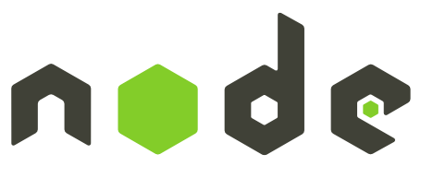
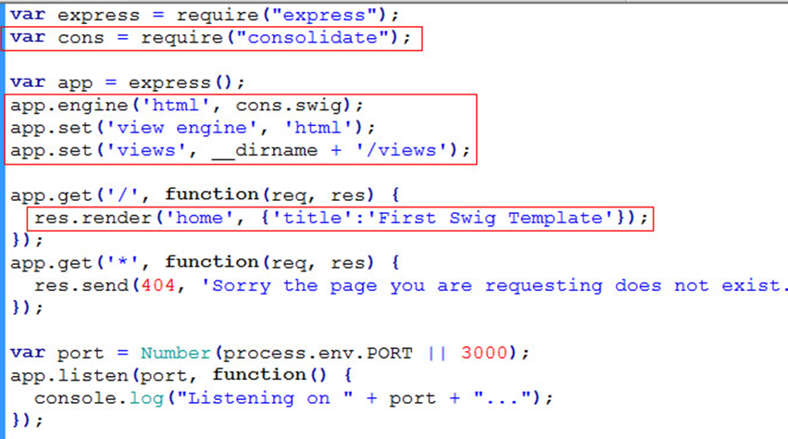

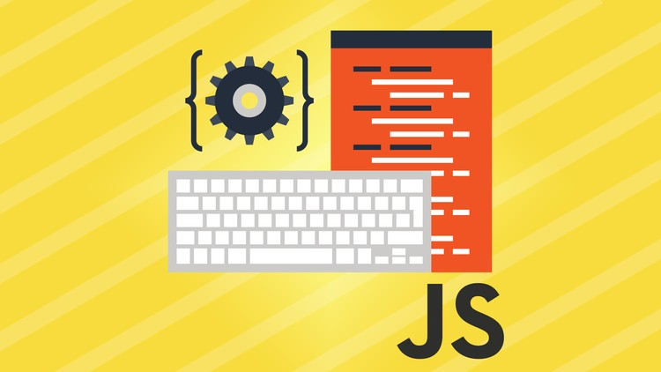
Table of Contents
Node.js
JS on the Server: Overview, Purpose, Installation
MVC Concepts - MVC Pattern Explained
Overview, Purpose
ExpressJS
What is ExpressJS?
MVC with ExpressJS
Routes, Controllers
Views – using handlebars.js

Slide 3
Have a Question?
sli.do #tech-softuni

Slide 4
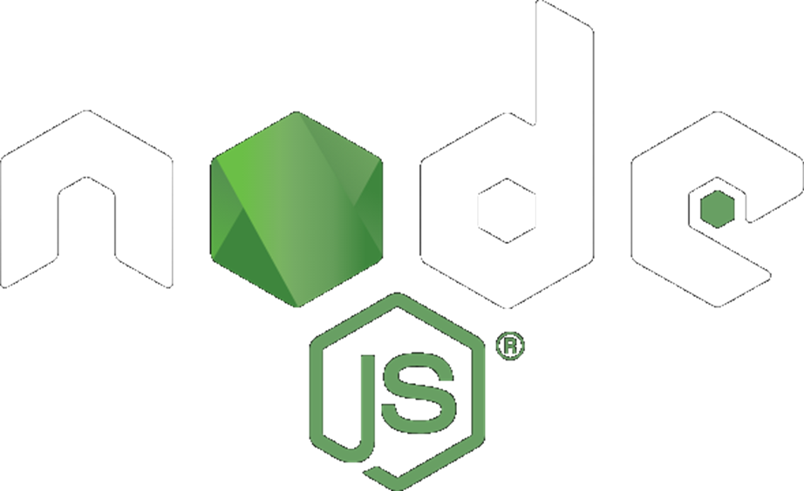
Node.js
The Server-Side JavaScript Runtime

Slide 5
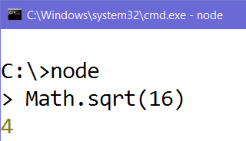
Node.js – What is It?
Node.js – JavaScript server-side runtime environment
Run JavaScript from the console
Flexible: use various modules
Scalable: works well for both small and large workloads
Can act as a Web server

Slide 6
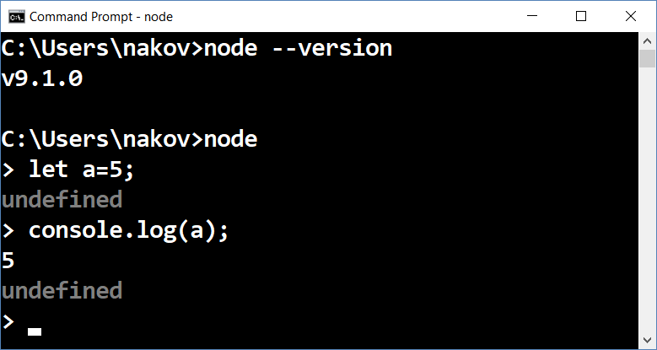
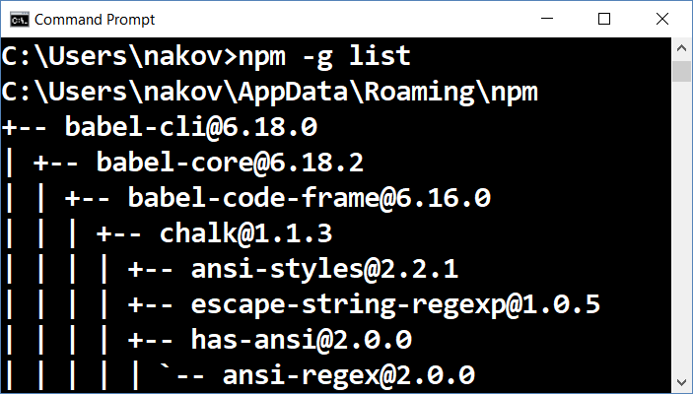
Installing Node.js
Install the Node.js environment from https://nodejs.org
Choose the latest version for your platform
Test the node and npm commands in the console

Slide 7
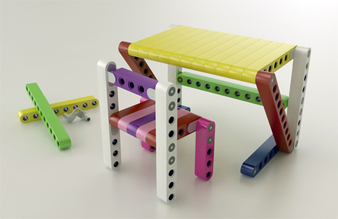
Node.js – Advantages
Developers can use whatever they want for:
Middleware
Authentication, Cookies, Sessions (User Login State)
Database connection + ORM (DB to Entity)
Sequelize, Mongoose, Bookshelf, etc.
Template (view) engines
Handlebars, Pug, Mustache, etc.

Slide 8
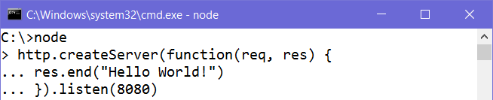
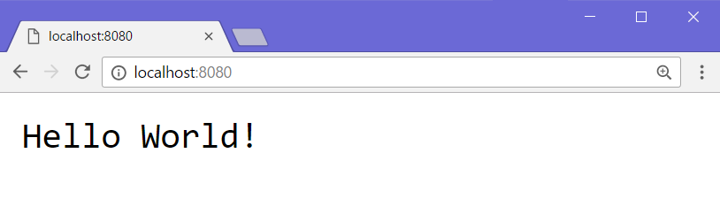
Node.js Example – Simple Web Server
Anonymous function
Send a response
Listen on port 8080
Request URL
HTTP Response
(rendered as web page)

Slide 9
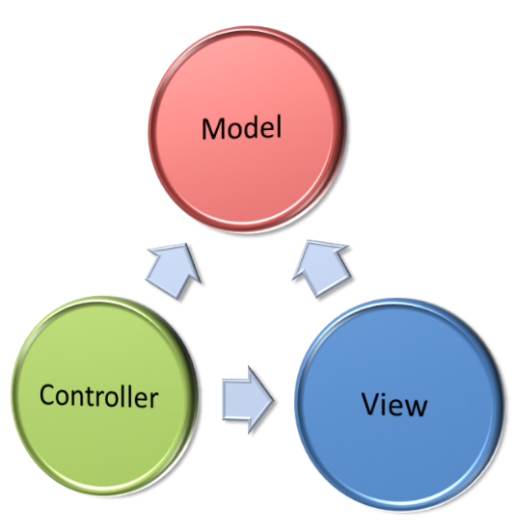
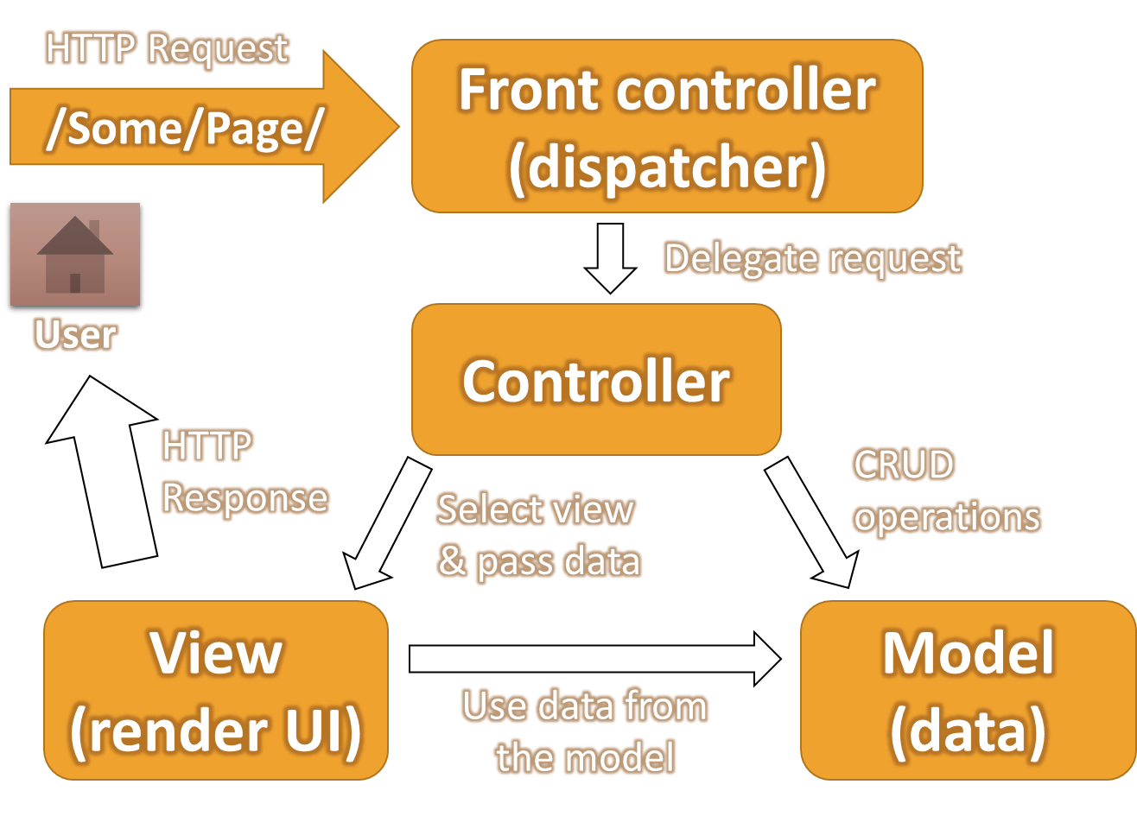
The MVC Pattern
Model-View-Controller

Slide 10

The MVC Pattern
Design pattern with three independent components
Model (data)
Manages data and database logic
View (UI)
Presentation layer (renders the UI)
Controller (logic)
Implements the application logic
Processes user request, performs an action, updates the data model and invokes a view to render some UI

Slide 11
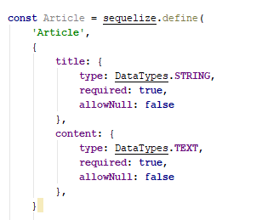
Model (Data)
Set of classes that describes the data we are working with
Rules for how the data can be changed and manipulated
May contain data validation rules
Often encapsulates data stored in a database
As well as code used to manipulate the data
E.g. Data Access Layer of some kind

Slide 12

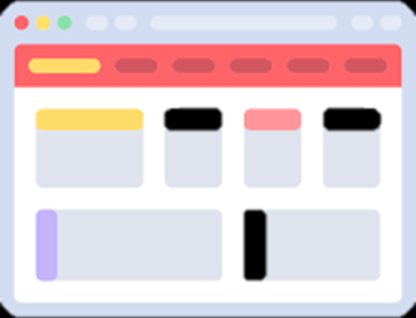

View (UI)
Defines how the application’s user interface (UI) will be displayed
May support master views (layouts)
May support sub-views (partial views or controls)
May use templates to dynamically generate HTML

Slide 13

Controller (Logic)
The core MVC component – holds the logic
Process the requests with the help of views and models
A set of classes that handles
Communication from the user
Overall application flow
Application-specific logic (business logic)
Every controller has one or more "actions"

Slide 14
The MVC Pattern (in Web Apps)
HTTP Request
/Some/Page/
Front controller (dispatcher)
Delegate request
User
Controller
HTTP Response
Select view & pass data
CRUD operations
View
(render UI)
Model (data)
Use data from
the model

Slide 15
MVC Workflow (in Web Apps)
Incoming request (HTTP request) is routed to a Controller
The Controller
Processes request and creates a View Model
Selects appropriate view to be rendered
The View Model is passed to View
View transforms the View Model into UI output format (HTML)
The response is rendered (HTTP response)

Slide 16
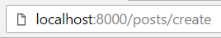
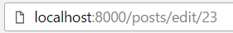
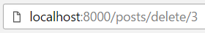
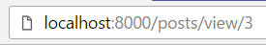
Example: Forum
Route (access URL)
PostController
Create(title, content)
Adds a forum post to the database
Edit(postId)
Gets post with id postId and alters the title and content in DB
Delete(postId)
Finds post by id postId and deletes it from the DB
View(postId)
Gets post with id postId and displays it to the user

Slide 17
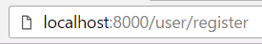
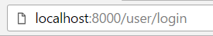
Example: Forum (2)
UserController
Register(username, passwd)
Adds a user to the database
Login(username, passwd)
Checks if user exists and if passwd matches the password in the database (after encryption)

Slide 18
ExpressJS
Web Framework for Node.js

Slide 19
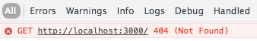
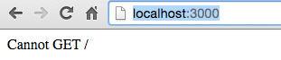
What is ExpressJS?
Web framework for Node.js
Handles GET / POST HTTP requests
Error handling (bad request, not found, unauthorized)
Advanced routing (parameters and wildcards supported)
Parameters
Wildcard (anything)
Parameters

Slide 20
Getting Started with ExpressJS
Install the ExpressJS framework with NPM
http://expressjs.com/en/starter/installing.html
Create a very simple ExpressJS app
http://expressjs.com/en/starter/hello-world.html
Play with the basic routing in ExpressJS
http://expressjs.com/en/starter/basic-routing.html

Slide 21
ExpressJS Routing
Express can listen on different routes
Execute different functions, based on route:
Specify HTTP Request method (GET / POST)
Function to execute when the route is matched
Express instance
URI (path on server)
Request & Response

Slide 22
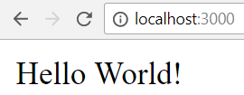
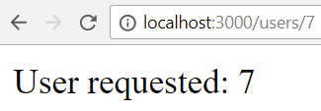
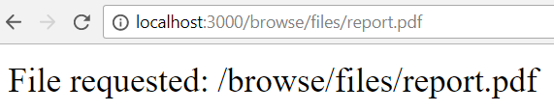
ExpressJS Routing – Example
app.get('/', (req, res) => {
res.send('Hello World!')
});
app.get('/users/:id', (req, res) => {
res.send('User: ' + req.params.id)
});
app.get('/browse/files/*', (req, res) => { res.send(
'File requested: ' + req.path)
});

Slide 23
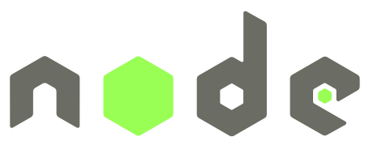

MVC with ExpressJS
Using Node.js, ExpressJS, Handlebars, Mongoose

Slide 24
Routes – routes.js
The file config/routes.js allows us to tell ExpressJS which routes trigger which controller action
const homeController = require('./../controllers/home');
const catController = require('./../controllers/cat');
module.exports = (app) => {
app.get('/', homeController.index);
app.get('/cat/details/:id', catController.details);
};
Import the cat controller
Handles GET requests
Route to listen on
Call the details function

Slide 25
Model – Sequelize
Using Sequelize, we can define our model schema:
const Cat = sequelize.define('Cat'{
name: {type: String, required: true},
age: {type: Number, min: 0, max: 100},
isAlive: Boolean
});
return Cat;
Model name
Validation
Model properties

Slide 26
View – Handlebars
HTML views with Handlebars templating syntax:
<div class="container body-content">
<div class="row">
<h2>{{cat.name}}</h2>
<p>Age: {{cat.age}}</p>
{{#if cat.isAlive}}
<p>Status: Alive</p>
{{else}}
<p>Status: Deceased</p>
{{/if}}
</div>
</div>
Handlebars syntax
HTML Code
Handlebars if/else

Slide 27
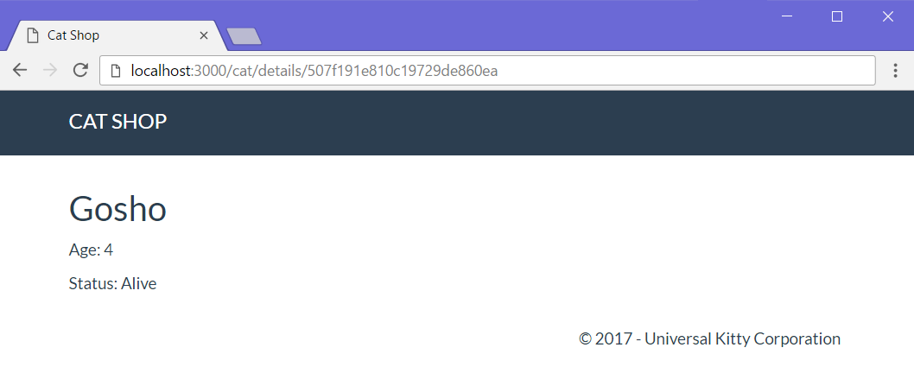
View – Handlebars (2)
Route: /cat/details/
req.params.id
{{cat.name}}
{{cat.age}}

Slide 28
Controller – ExpressJS
Import the Cat model
Example – catController.js:
const Cat = require('../models').Cat;
module.exports = {
catdetailsGet: (req, res) => {
let id = req.params.id;
Cat.findById(id).then(cat => {
if (!cat) {
res.render('error', { errorMsg: '404: Cat Not Found!' });
}
res.render('cat/details', { cat: cat });
});
};
};
Controller action
Find cat in DB by id
Render error view
Render cat/details view
Pass parameters to view

Slide 29
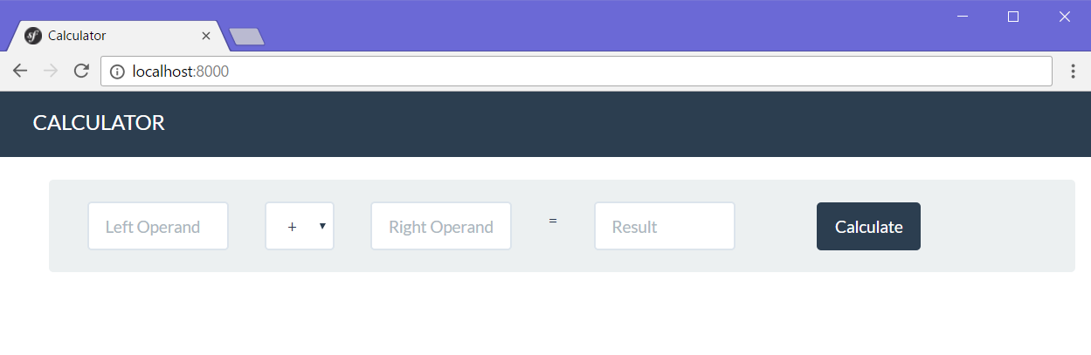
Problem: Simple Calculator Web Application
Write a web application, which can calculate the result between two operands
Implement addition, subtraction, multiplication and division

Slide 30
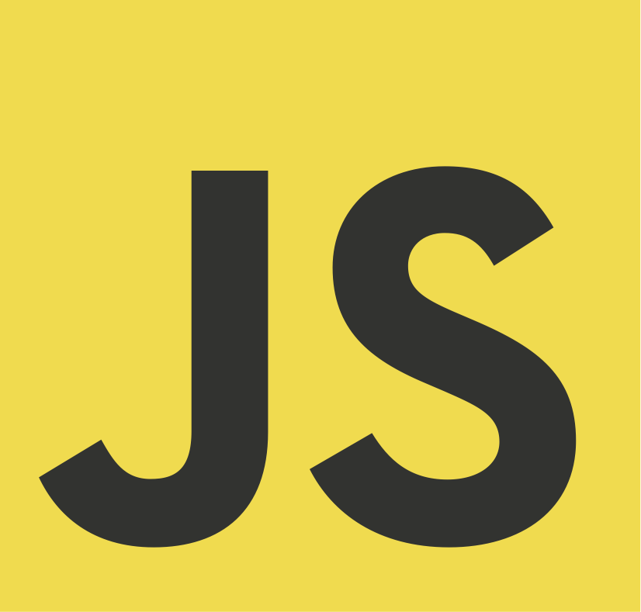
Web Application with ExpressJS
Live Exercises in Class (Lab)

Slide 31


Summary
Node.js
JavaScript runtime environment
Establishes communication between the server, and the client
ExpressJS
Web framework for Node.js
Implementing the MVC pattern with JavaScript
Using Node.js, Mongoose, ExpressJS and Handlebars

Slide 32

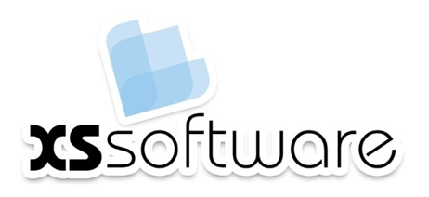








JavaScript: ExpressJS Overview
https://softuni.bg/courses/software-technologies

Slide 33
License
This course (slides, examples, demos, videos, homework, etc.) is licensed under the "Creative Commons Attribution-NonCommercial-ShareAlike 4.0 International" license

Slide 34





Trainings @ Software University
Software University Foundation – softuni.org
Software University – High-Quality Education, Profession and Job for Software Developers
softuni.bg
Software University @ Facebook
facebook.com/SoftwareUniversity
Software University Forums – forum.softuni.bg

